Slide 1
Title: Wireless Chargers(Use electromagnetic induction to transfer power wirelessly)
Course Title : Wireless and Mobile Communication Course Code : ICT - 4201 Name : Mahmudul Hasan
ID : IT-21019

Slide 2
Introduction
Wireless charging = Charging without cables.
Uses electromagnetic induction to transfer energy between two coils.
First demonstrated by Nikola Tesla in the late 19th century.
Widely used in smartphones and EVs today.
Based on Faraday’s Law of Electromagnetic Induction.
Faraday’s Law : “A changing magnetic field in one coil induces an electric current in another nearby coil.”
Notes:
without physical connectors.

Slide 3
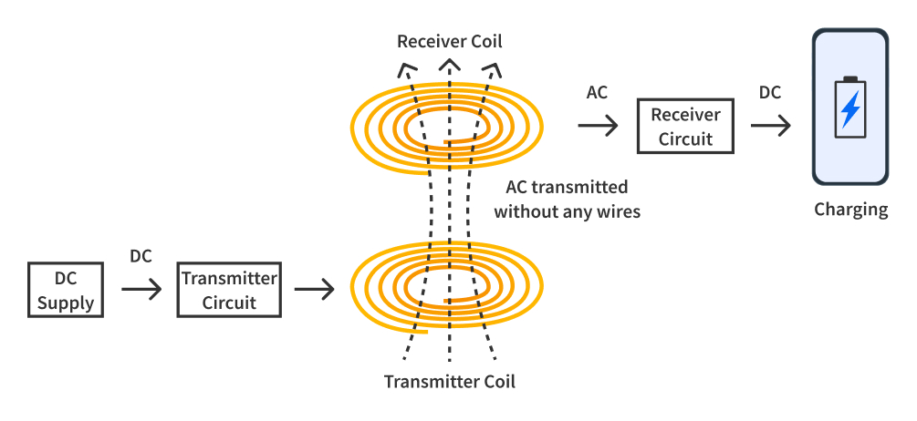
Introduction
Visual:

Slide 4
Introduction
Standards Used
Qi Standard (WPC – Wireless Power Consortium): Most popular standard for smartphones.
PMA (Power Matters Alliance): Used in some public charging stations.
Notes:
QI 2 + Magsafe iPhone Model
iPhone 8 – 11
Qi
7.5 W
Standard wireless charging
iPhone 12 – 14
Qi + MagSafe
15 W
Magnetic alignment
iPhone 15 series
Qi2 + MagSafe
15 W
Universal magnetic Qi2 support

Slide 5
Basic Principle
Alternating current (AC) in the transmitter coil → creates magnetic field.
Receiver coil inside device captures this magnetic field.
Induced AC → converted to DC → charges battery.
Key law: Faraday’s Law of Electromagnetic Induction.

Slide 6
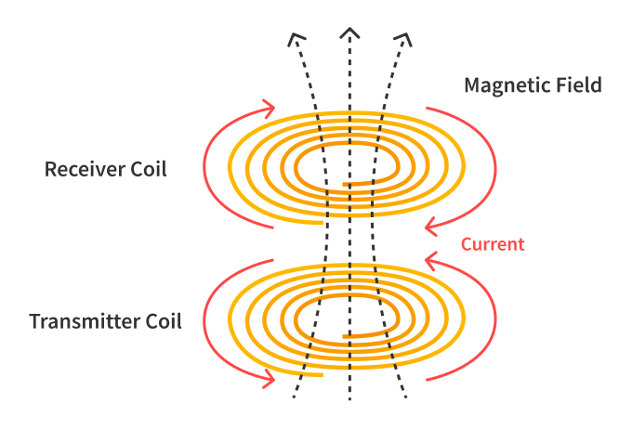
Components
Transmitter Coil (Charging Pad)
Receiver Coil (Inside Device)
Power Source & Control Circuit
Rectifier Circuit (Converts AC → DC)

Slide 7
Working Process
Power flows into transmitter coil → magnetic field generated.
Device placed near pad → receiver coil picks up magnetic flux.
Induced voltage → converted into DC.
Battery starts charging safely.

Slide 8
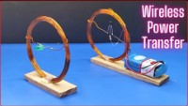
Working Process

Slide 9
Advantages
No cable clutter.
Reduced wear on ports.
Water & dust resistant design.
Safe and user-friendly.

Slide 10
Limitations
Lower efficiency than wired chargers.
Slow charging rate.
Needs close alignment.
Generates heat during operation.

Slide 11
Applications
Smartphones & Wearables.
Electric Vehicles (EVs).
Medical devices.
Industrial automation.

Slide 12
Future Scope
Resonant wireless charging (longer range).
Multiple device charging pads.
Dynamic charging for EVs while moving.
Smart power management systems.

Slide 13
Conclusion
Wireless charging is a smart and convenient technology that uses electromagnetic induction to transfer power without cables. It has made charging easier, safer, and more efficient for modern devices. Though it still faces limits like slower speed and short range, new innovations such as MagSafe and Qi2 are shaping a faster and smarter wireless future.

Slide 14
Thank You

